Slide 1



Understanding AI Agents
AI agents are autonomous software programs that can perceive their environment, make decisions, and take actions to achieve specific goals. They leverage artificial intelligence to exhibit intelligent behavior, learn from experience, and adapt to changing conditions.
by Shawaal Api
SA

Slide 2

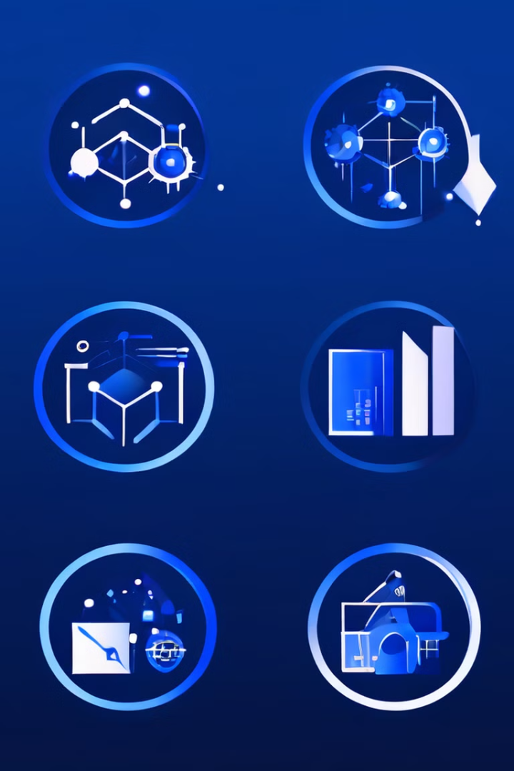
Definition of AI Agents
AI agents are intelligent software systems that can sense their environment, process information, make decisions, and perform actions independently to accomplish predefined objectives. They are designed to exhibit autonomous, flexible, and goal-oriented behavior.

Slide 3

Key Characteristics of AI Agents
1
Autonomy
2
Responsiveness
AI agents can operate without direct human intervention, making their own decisions based on their goals and environmental conditions.
AI agents can perceive and respond to changes in their environment, adapting their behavior accordingly.
3
Goal-Orientation
4
Learning and Adaptation
AI agents are designed to pursue specific objectives and take actions to achieve their goals.
AI agents can learn from their experiences and continuously improve their performance over time.

Slide 4
Types of AI Agents
Reactive Agents
Deliberative Agents
Hybrid Agents
Reactive agents respond to their environment in a stimulus-response manner, without maintaining an internal model of the world.
Deliberative agents use reasoning and planning to choose the best course of action to achieve their goals, based on an internal model of the world.
Hybrid agents combine elements of both reactive and deliberative agents, using a mix of immediate responses and long-term planning.

Slide 5





Applications of AI Agents
Robotics
Information Retrieval
AI agents are used in autonomous and semi-autonomous robots to control their movement, decision-making, and interaction with the environment.
AI agents are employed in search engines and personal assistants to understand user queries and provide relevant information.
Network Management
Smart Home Automation
AI agents can be used to monitor, analyze, and optimize the performance of complex computer networks.
AI agents can be integrated into smart home systems to automate various tasks and optimize energy usage.

Slide 6




Benefits of AI Agents
Efficiency
AI agents can perform tasks faster and more consistently than humans, improving productivity and reducing errors.
Flexibility
AI agents can adapt to changing environments and handle complex, dynamic tasks that would be challenging for humans.
Scalability
AI agents can be replicated and deployed at scale, allowing for the automation of large-scale operations.

Slide 7

Challenges in Developing AI Agents
Complexity
Transparency
Designing AI agents that can effectively perceive, reason, and act in complex, real-world environments is a significant challenge.
Ensuring that AI agents' decision-making processes are transparent and accountable is crucial for building trust and acceptance.
Safety and Ethics
Data Acquisition
Developing AI agents that behave in a safe, ethical, and socially responsible manner is a critical concern.
Obtaining the vast amounts of high-quality data required to train and refine AI agents can be a significant hurdle.

Slide 8

The Future of AI Agents
As AI continues to advance, the role and capabilities of AI agents are poised to grow exponentially. Researchers and developers are working to create more sophisticated, autonomous, and collaborative AI agents that can tackle increasingly complex challenges in fields such as healthcare, transportation, and scientific research, transforming the way we live and work.

